Slide 1
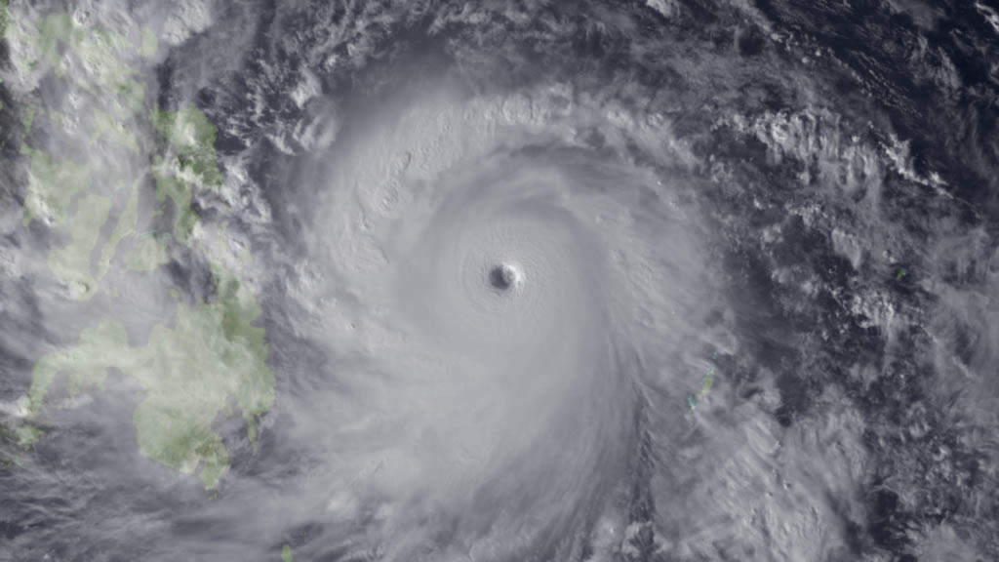
69th Interdepartmental Hurricane Conference
2015 Tropical Cyclone Research Forum
Typhoon Haiyan
Tropical Cyclone Operations and Research:
Setting our Future Course
March 1 – 5, 2015
Notes:
Leave this slide on the screen as the FC walks to podium

Slide 2
Session 6
Mr. David McCarren
Federal Coordinator for Meteorology (Acting)
Future of the
Interdepartmental Hurricane Conference
Agency Perspectives
Open Discussion
The Office of the Federal Coordinator for
Meteorological Services and Supporting Research
(OFCM)

Slide 3
Current State
Goods
Bads
Others

Slide 4
Leadership Briefings
Comment

Slide 5
Organizing Committee
Comment

Slide 6
Meeting Timing and Frequency
Comment

Slide 7
Location
Comment

